Slide 1

OpenShift Ingress in a Multi-Cluster World with NGINX + BIG-IP
Mark Dittmer
Product Management

Slide 2
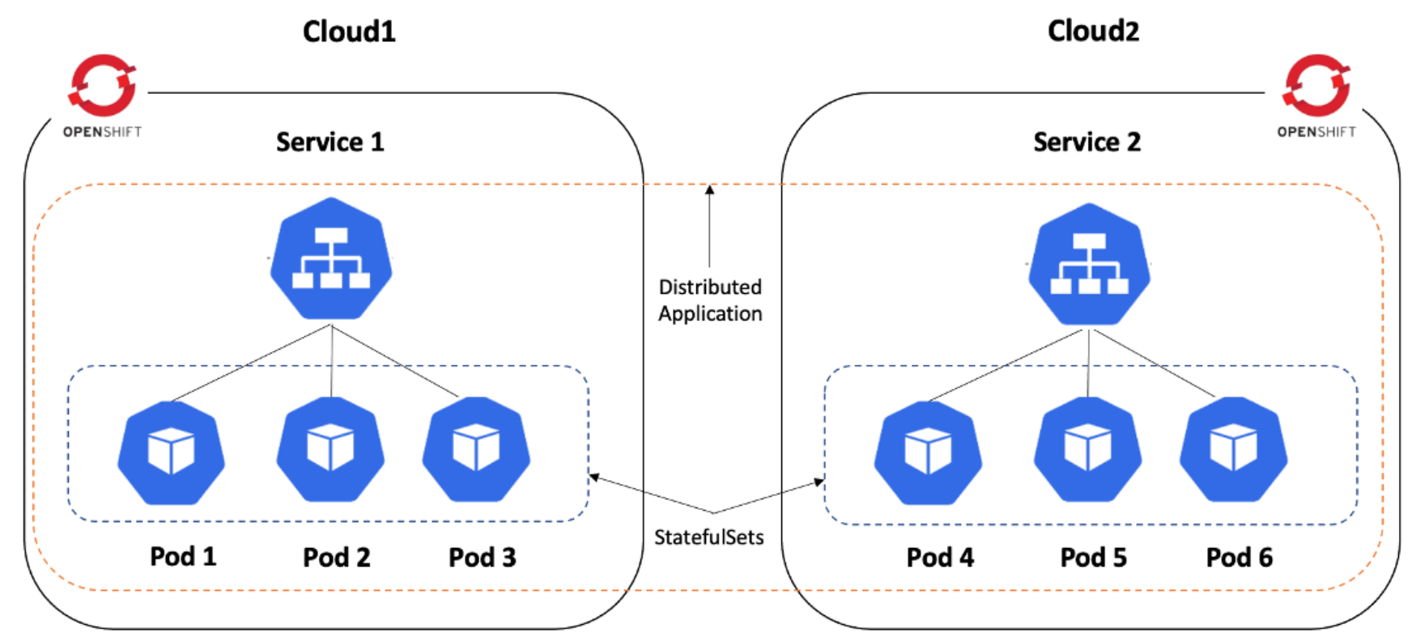
Agenda
The Role of LB in OpenShift
Advanced Traffic Management with Ingress sharding
Focus in Multi cluster

Slide 3
Basic BIG-IP integration with OpenShift
The basic NetOps use case

Slide 4




The Role of LB in OpenShift
The canonical architecture
Cluster
Ingress
controller
Workload PODs
External LB
NodePort
Node 1
Only L4, unable to access
the internal cluster network
Node 2
Internal cluster network
(aka CNI)
L7

Slide 5
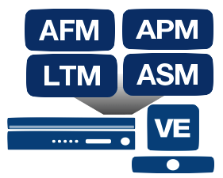

BIG-IP architecture for OpenShift
Using BIG-IP as External LB or External LB + Ingress Controller
L4 and L7publishing
2-tier
LB deployment
Workload PODs
Workload PODs
1-tier
LB deployment
Workload PODs
BIG-IP LB can send traffic directly to inside the cluster

Slide 6
Advanced Traffic Management with Ingress sharding

Slide 7



Ingress sharding
Balance Ingress Controllers, or routers, with several routes to speed up responses to changes.
Allocate certain routes to have different reliability guarantees than other routes.
Allow certain Ingress Controllers to have different policies defined.
Allow only specific routes to use additional features.
Expose different routes on different addresses so that internal and external users can see different routes, for example.
Transfer traffic from one version of an application to another during a blue green deployment.
Distribute a set of routes across multiple routers/ingress controllers
Shard-A
www.sharded.com/
www.sharded.com/shop
www.sharded.com/checkout
Shard-B
account.sharded.com
F5 BIG-IP
operating at Layer 7
Shard-C
Shard-D

Slide 8
Focus in Multi cluster

Slide 9



Multi-cluster OpenShift
Overview
Regular external LB without multi-cluster support
OpenShift Cluster 1
(version 4.x)
VIP Cluster 1
VIP Cluster 2
VIP Cluster N
OpenShift Cluster 2
(version 4.y)
.
.
.
.
OpenShift Cluster N
(version 4.z)

Slide 10
Multi-cluster OpenShift
Overview
F5 BIG-IP with multi-cluster enabled
OpenShift Cluster 1
(version 4.x)
VIP multi-cluster
Use cases:
OpenShift migrations (this applies to single cluster customers too)
Increase capacity
OpenShift high availability (ie: maintenance windows)
Blue-green (A/B testing)
Route sharding across clusters
OpenShift Cluster 2
(version 4.y)
.
.
.
.
LB methods:
Active-Active
Active-Standby
Ratio
1-tier and 2-tier deployments possible
OpenShift Cluster N
(version 4.z)

Slide 11
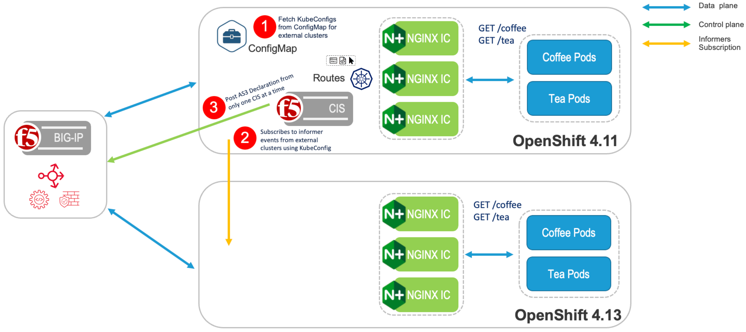
Multi cluster Demo Demonstration of how NGINX Ingress Controller combined with F5 BIG-IP and Container Ingress Services (CIS) can help scale, secure, and provide visibility into Red Hat OpenShift in a multi-cluster world

Slide 12
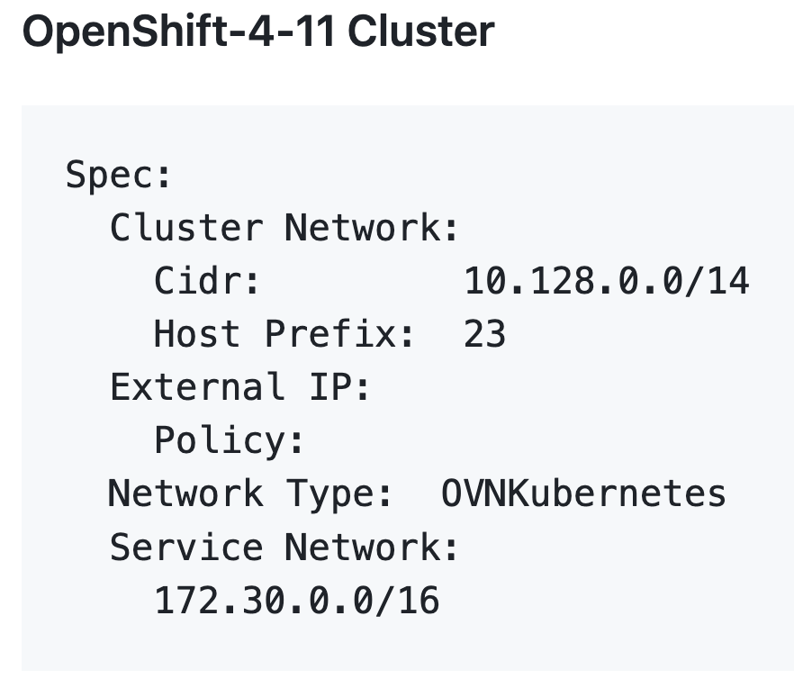
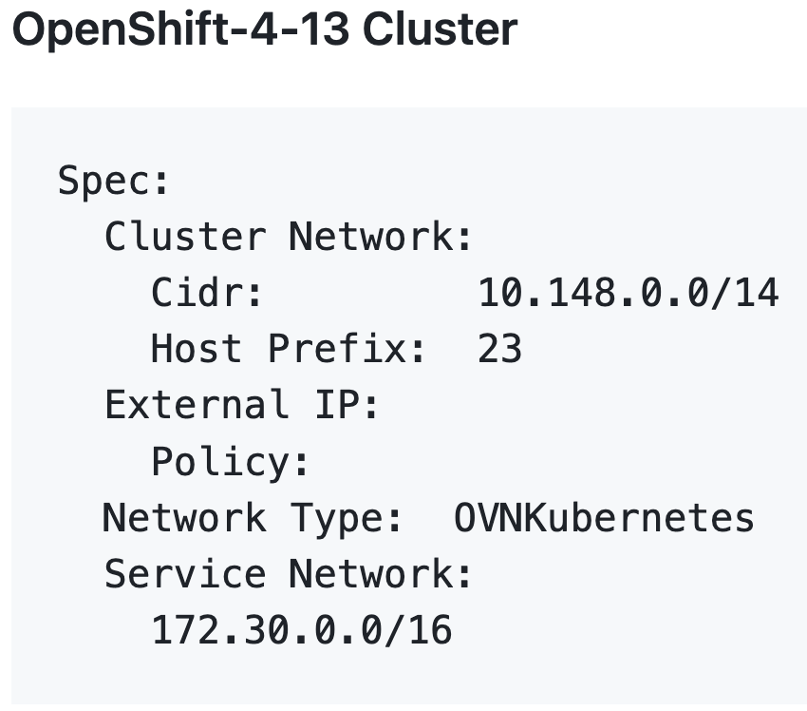
Re-thinking Networking Challenges using OVNKubernetes

Slide 13
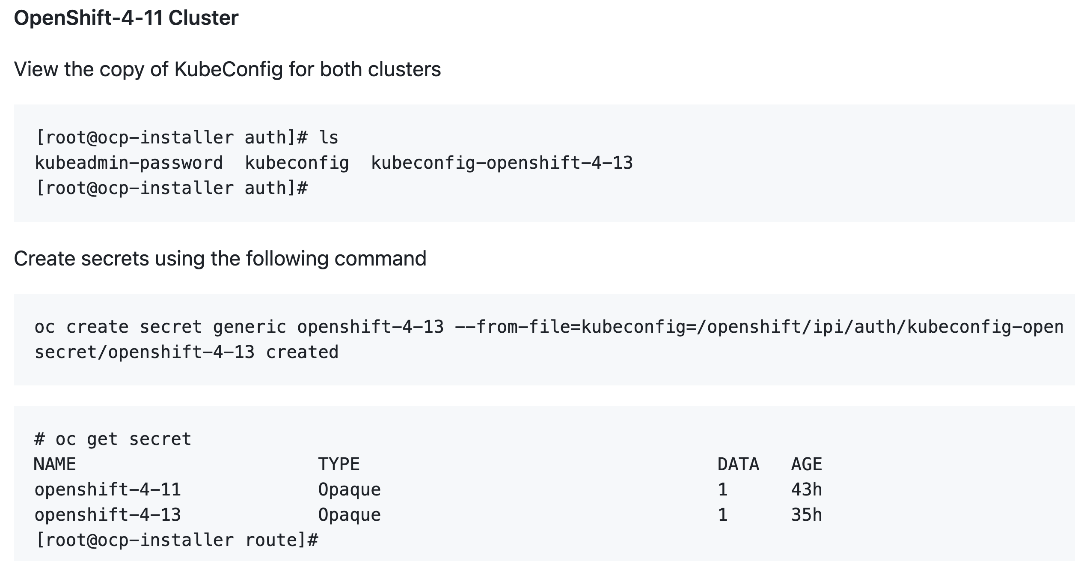
Monitoring External Clusters

Slide 14
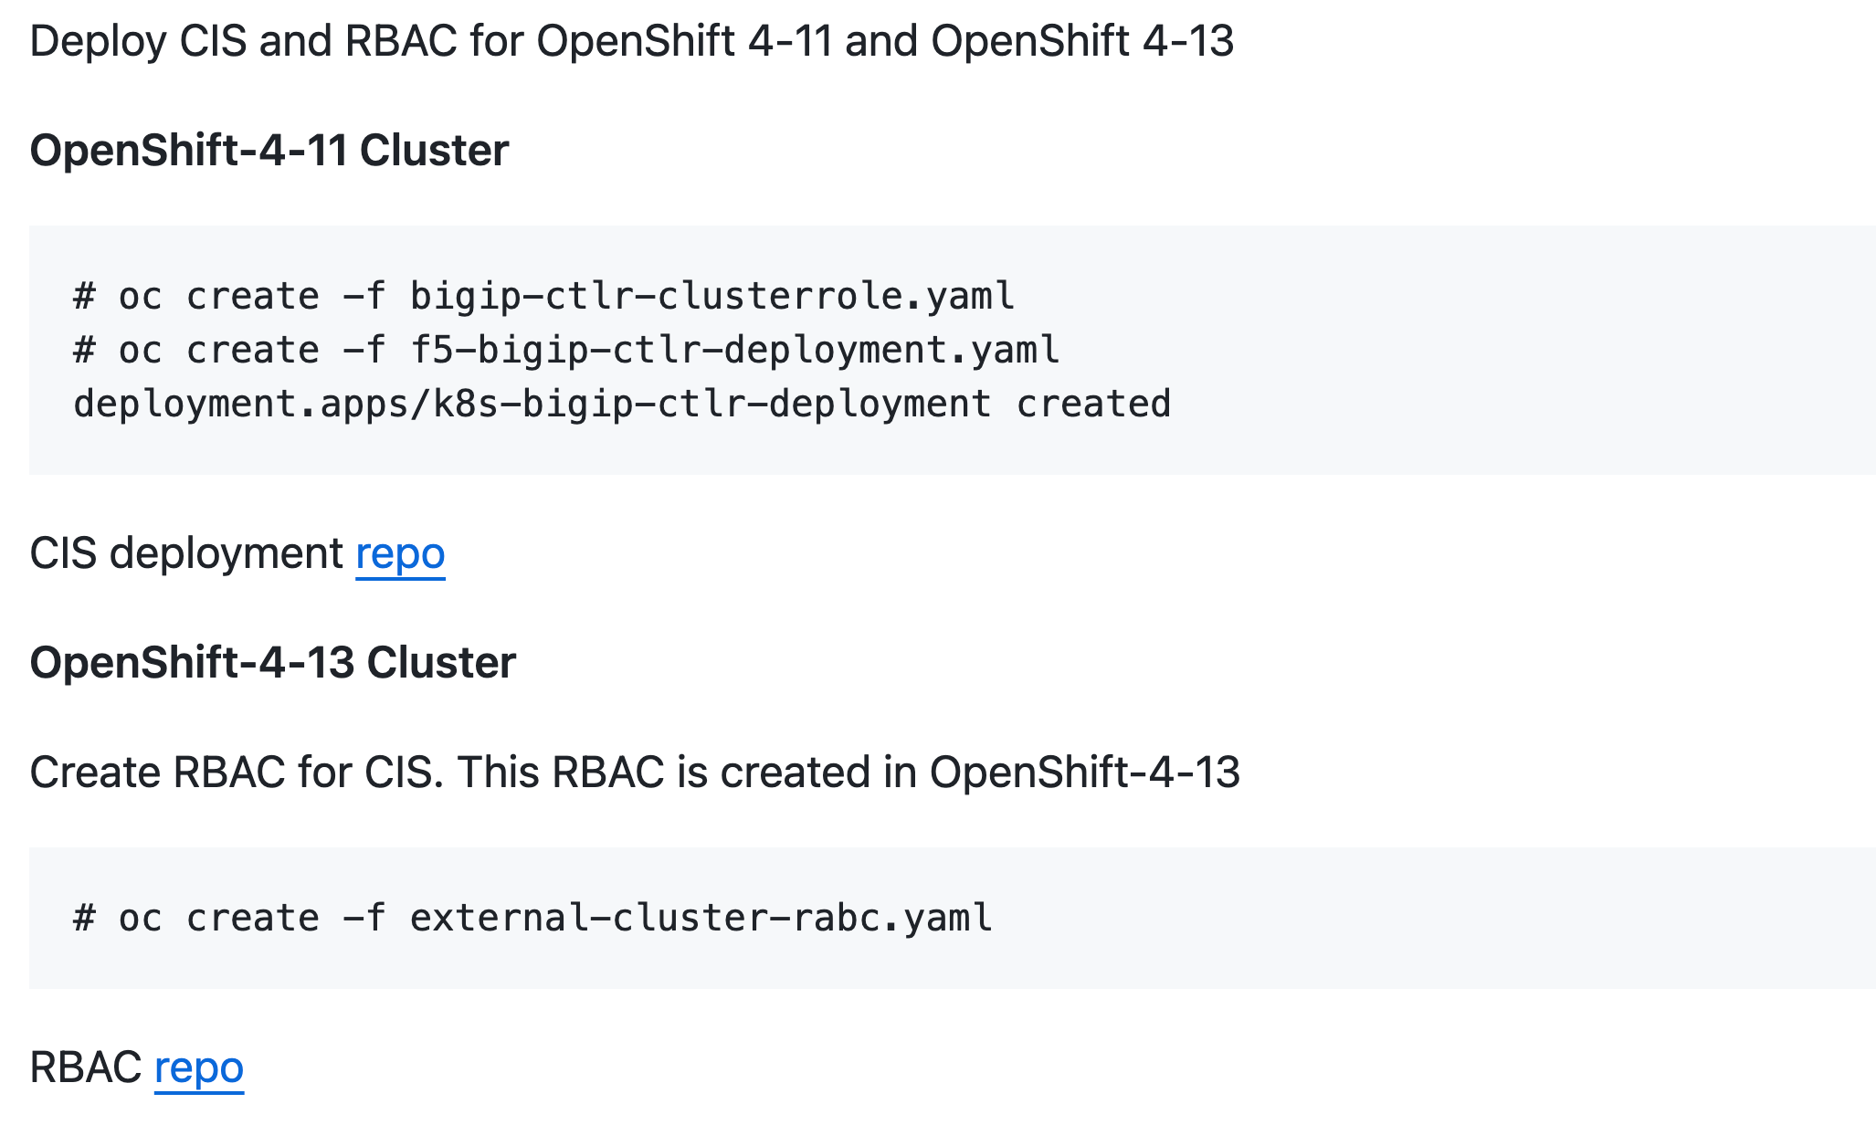
Deploy BIG-IP Controller in Primary Cluster

Slide 15
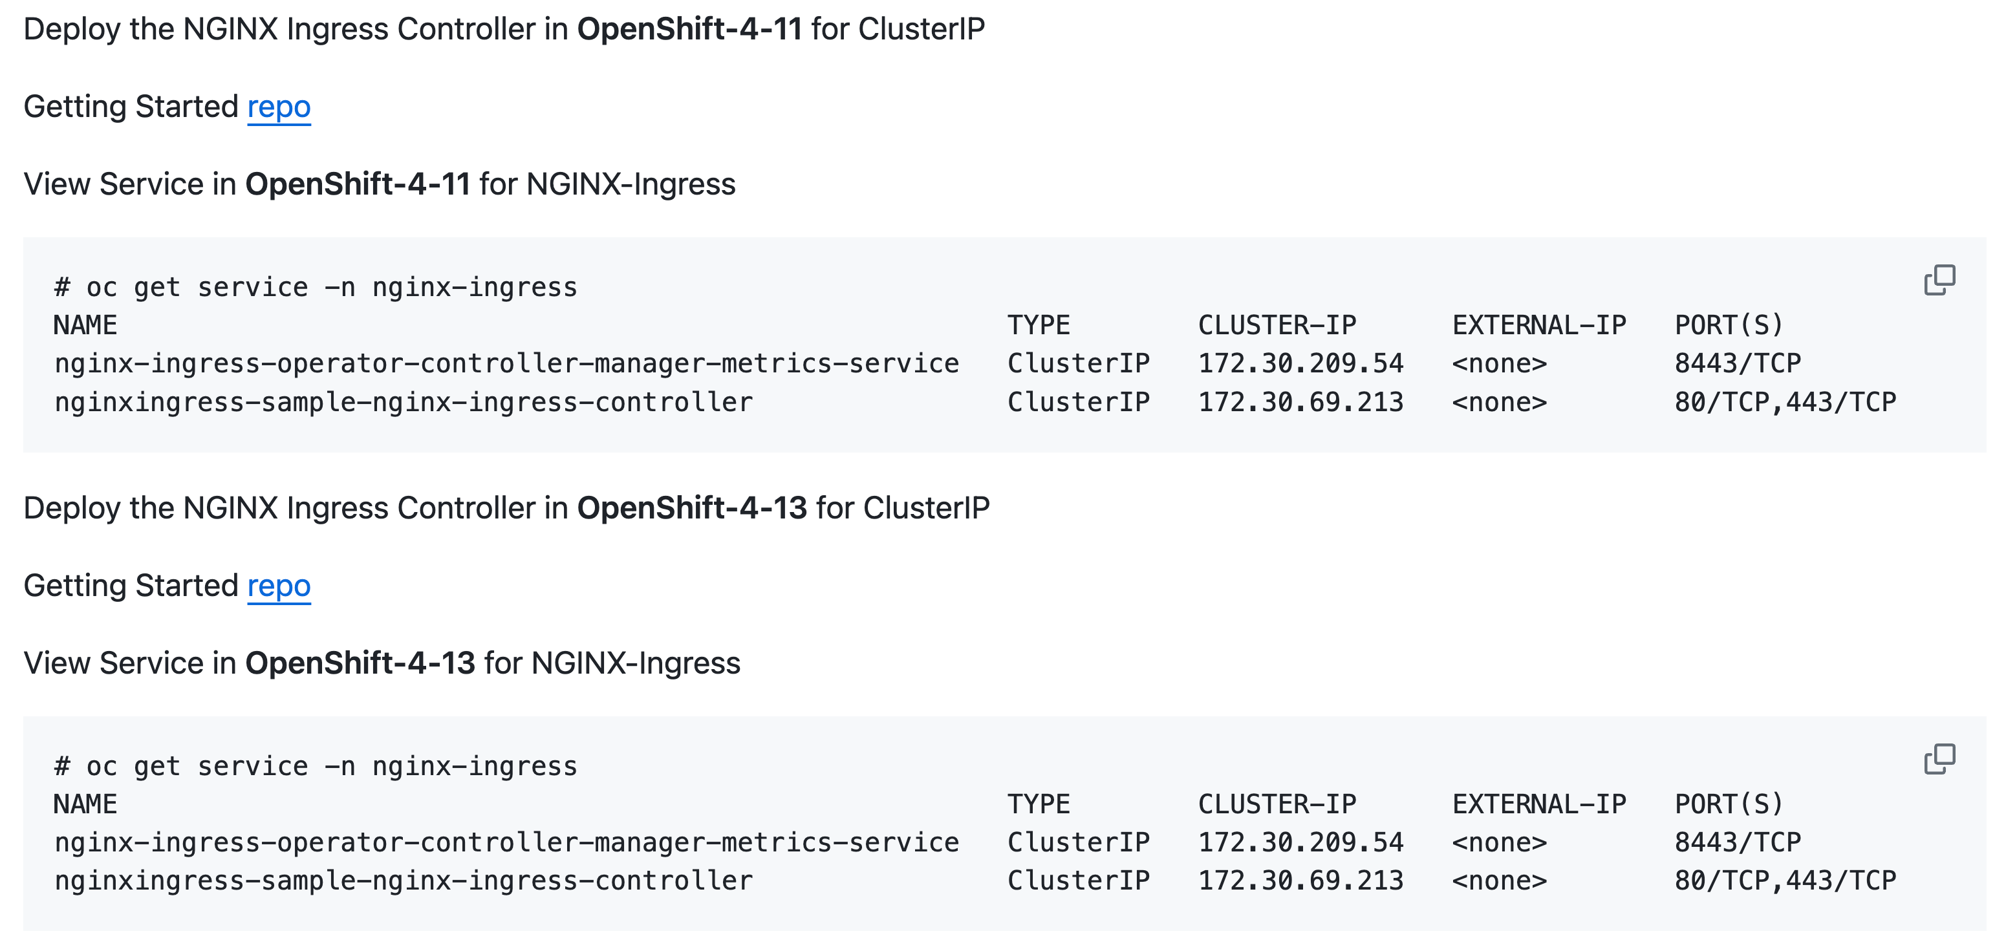
NGINX Ingress Controller in both Clusters

Slide 16
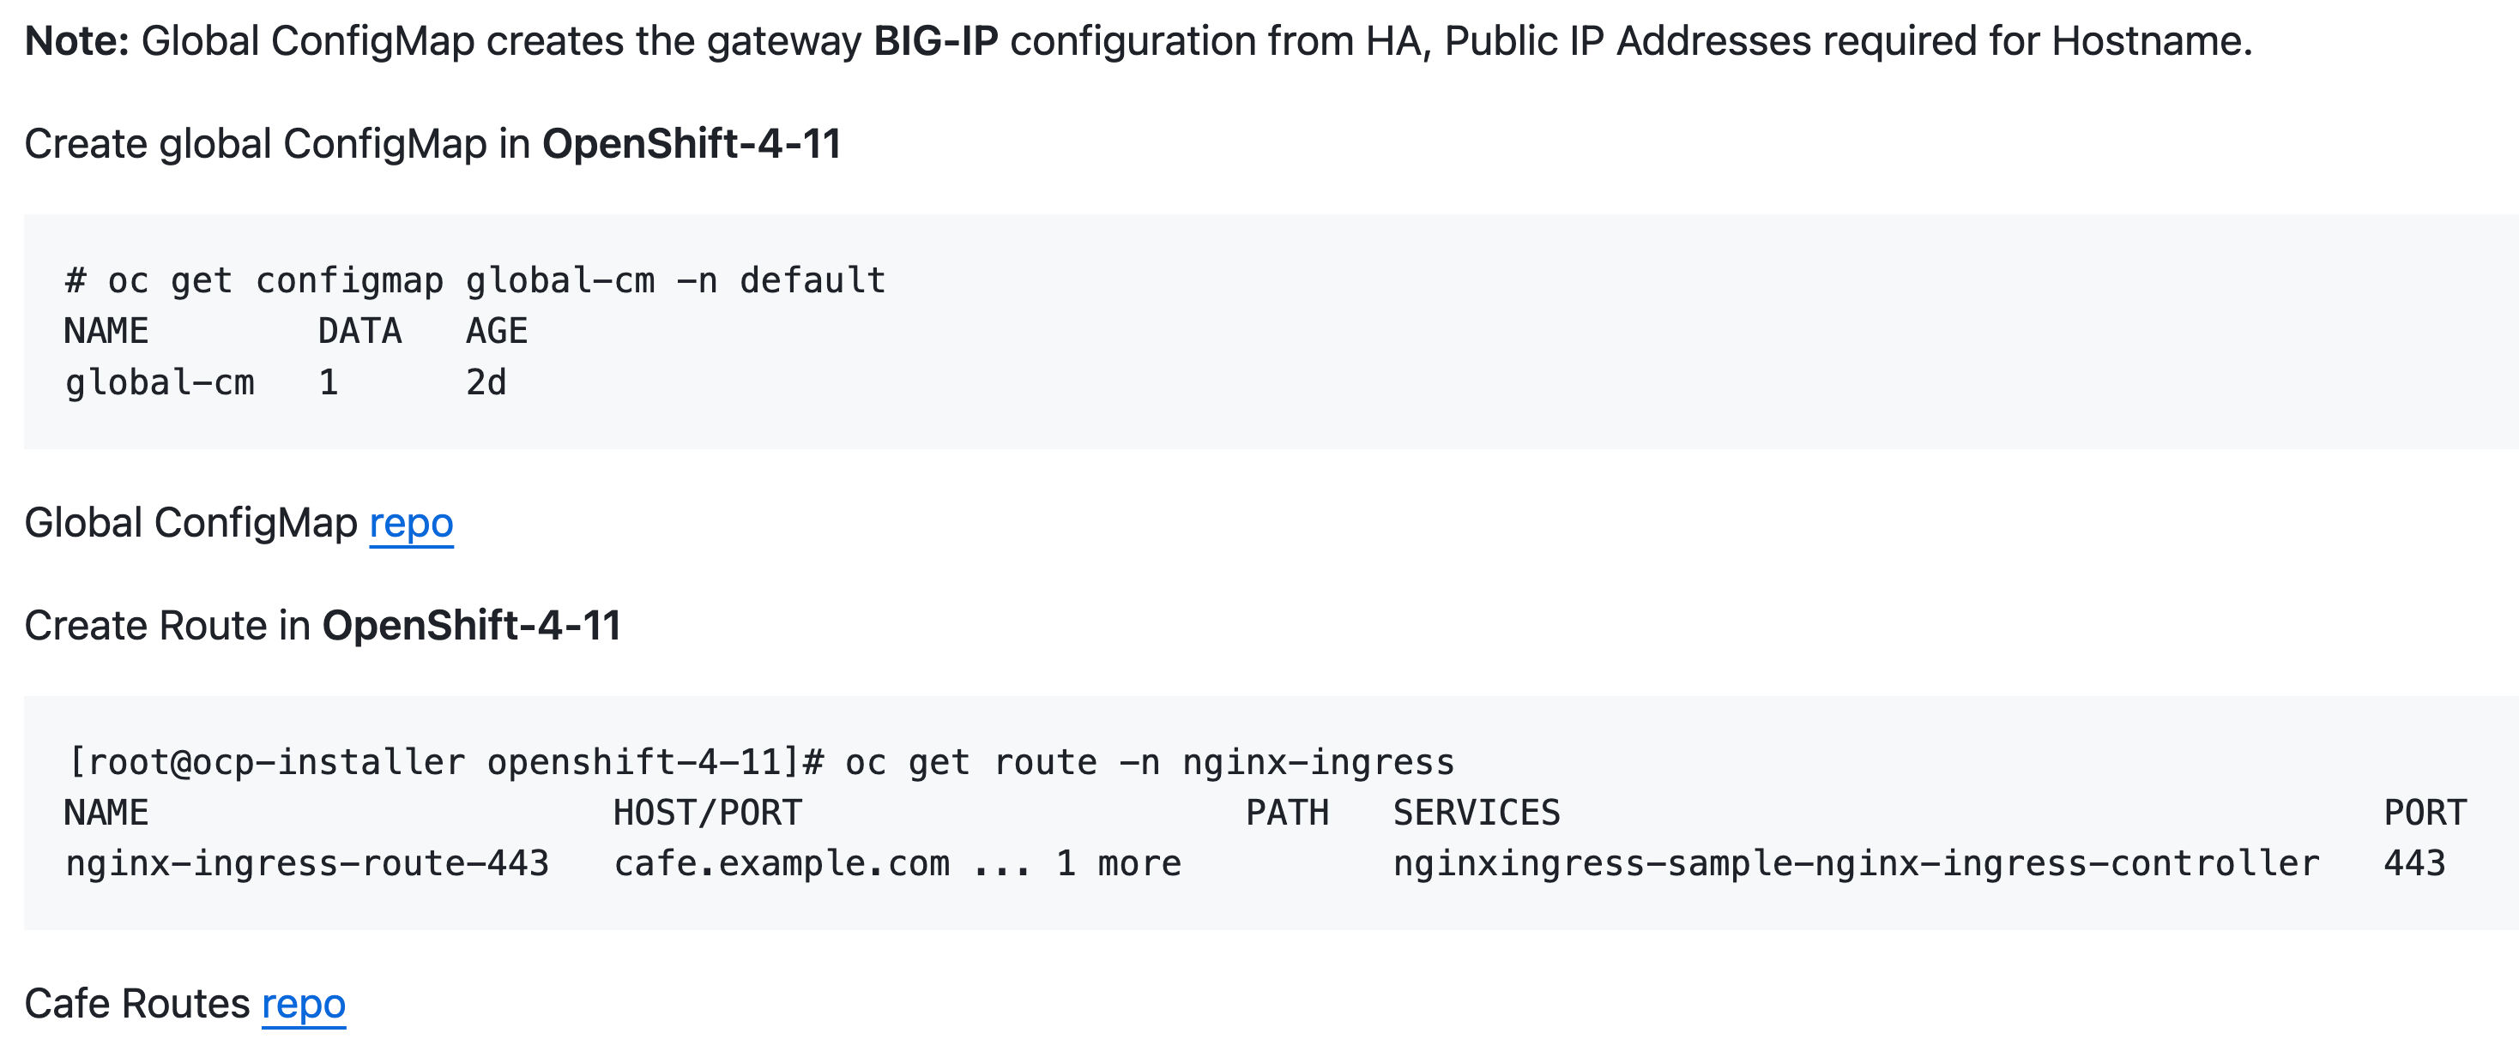
Last - Create Ingress Routes or Sharding

Slide 17
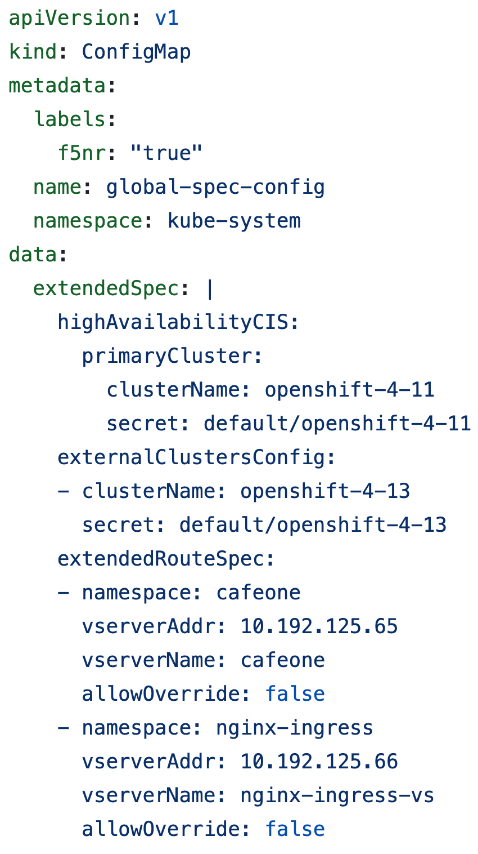
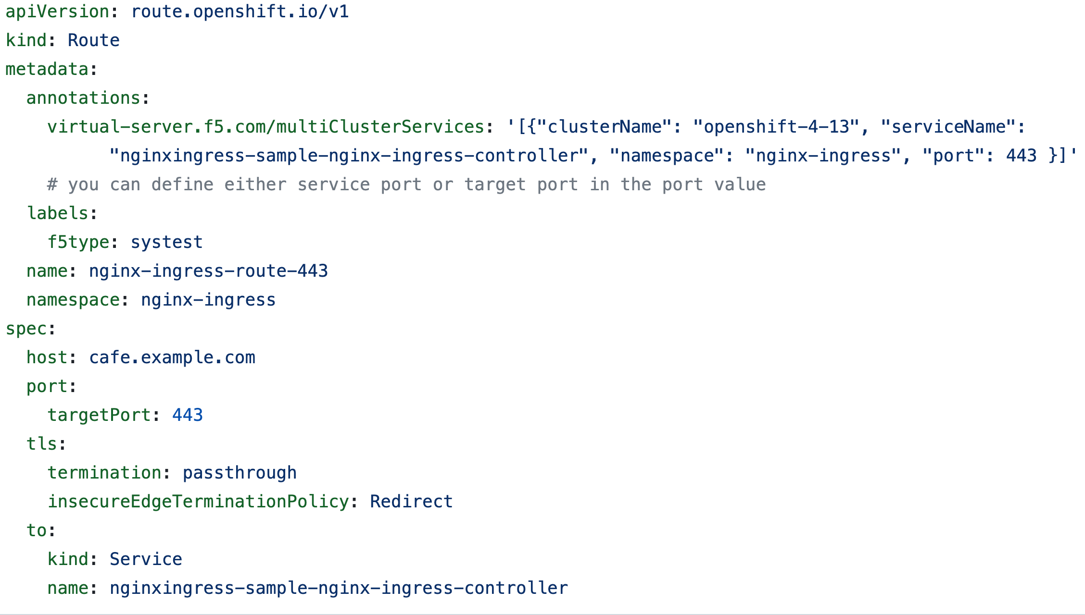

Review Ingress Sharding for Multi-Cluster

Slide 18
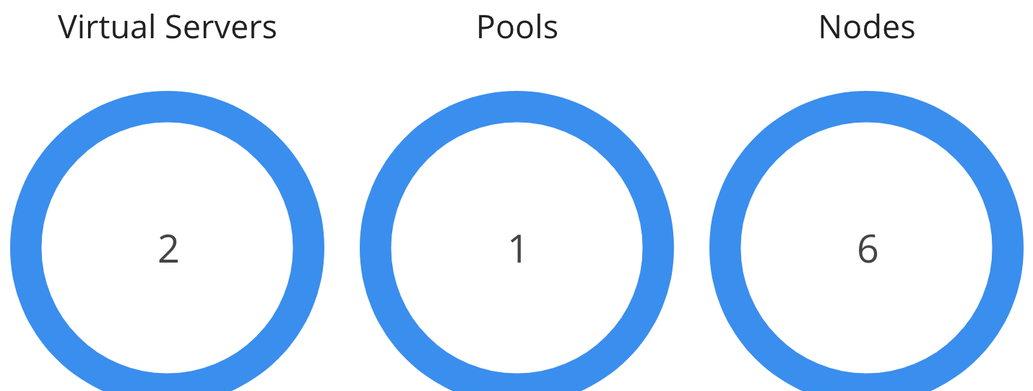
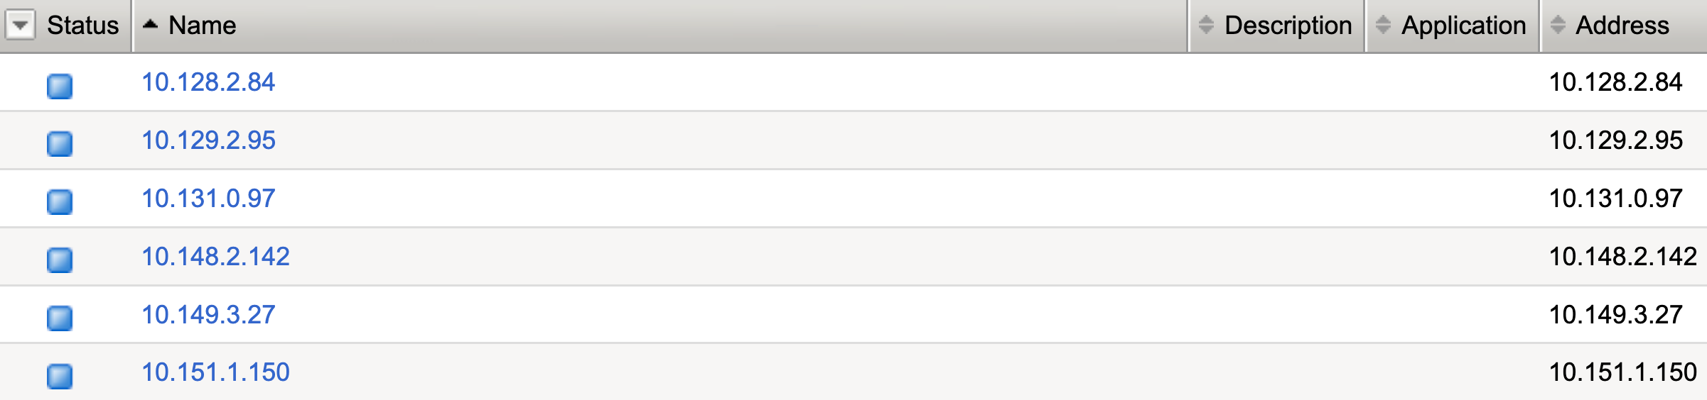
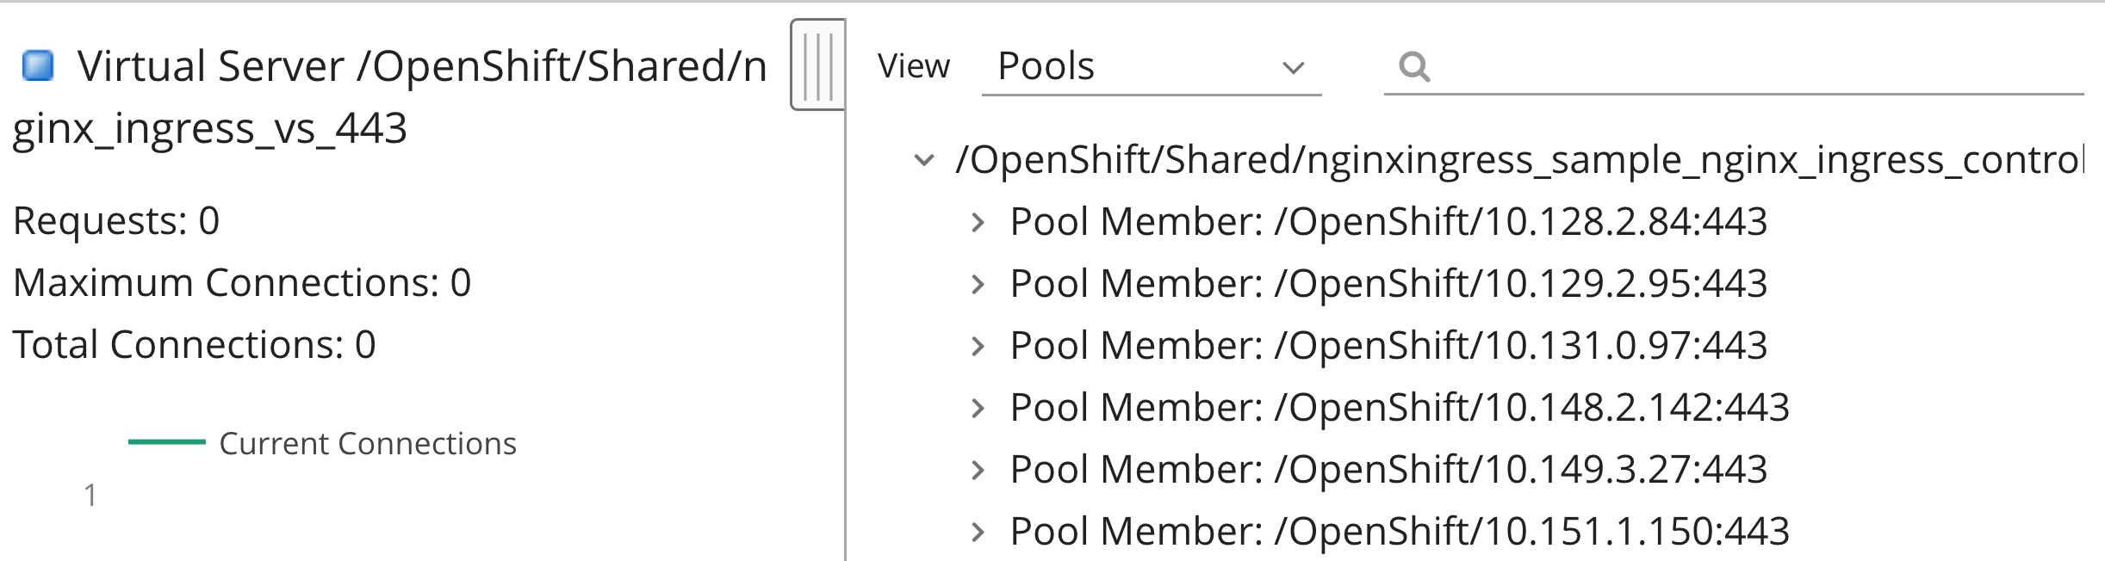
Magic!! Endpoints split across two clusters

Slide 19


The END!

